Slide 1
Letter recognition by machine learning classification models
Jammy Chan

Slide 2
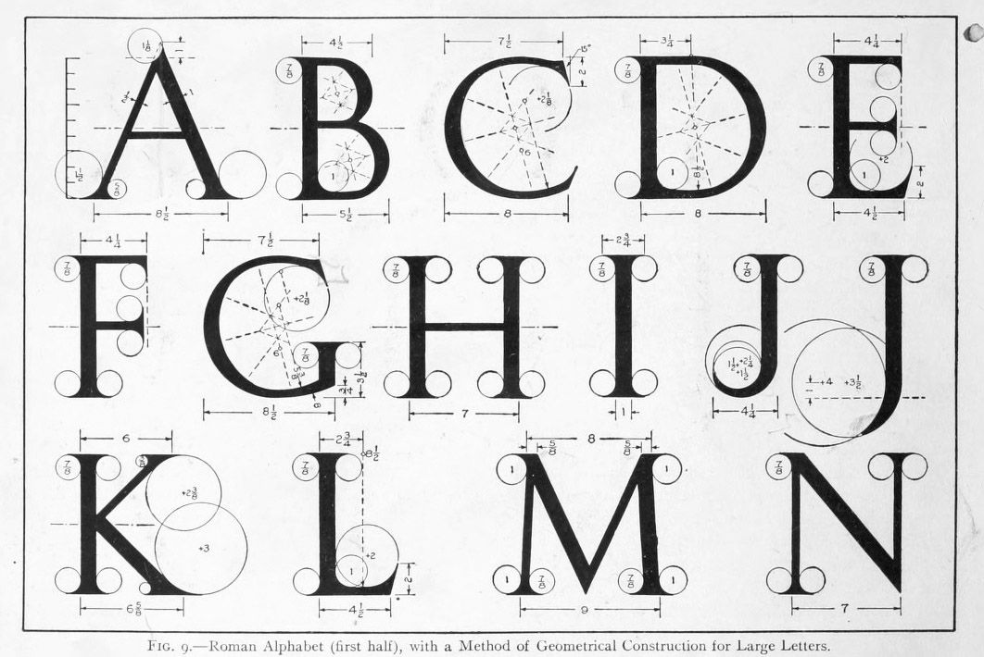
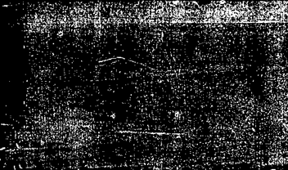
Goal
Identify each of a large number of black-and-white rectangular pixel displays as one of the 26 capital letters in the English alphabet
measurement
The character images were based on 20 different fonts and each letter within these 20 fonts was randomly distorted to produce a file of 20,000 unique stimuli. Each stimulus was converted into 16 numerical attributes (position and edge measurements)

Slide 3
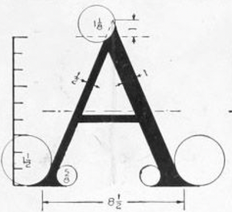
Data attributes
Name | Description
letter | capital letter (26 values from A to Z) – this is the prediction label
x_box | horizontal position of box (integer)
y_box | vertical position of box (integer)
width | width of box (integer)
height | height of box (integer)
total_pixels | total # of pixels (integer)
mean_x_pixels | mean x of on pixels in box (integer)
mean_y_pixels | mean y of on pixels in box (integer)
mean_x_variance | mean x variance (integer)
mean_y_variance | mean y variance (integer)
mean_xy_corr | mean x y correlation (integer)
mean_x2y | mean of x * x * y (integer)
mean_xy2 | mean of x * y * y (integer)
x_edge | mean edge count left to right (integer)
x_edgey | correlation of x-edge with y (integer)
y_edge | mean edge count bottom to top (integer)
y_edgex | correlation of y-edge with x (integer)

Slide 4
Data distribution & imbalance validation
Shannon entrophy
BL = H / log(k)
P_{i} is probability of each class
k is the number of class
BL = 1 → Balance
BL = 0 → Imbalance
BL = 0.999866184526204

Slide 5
Data preprocessing
Splitting – separate label and features
letters_labels = letters_data_raw['letter']
letters_data = letters_data_raw.drop(columns=['letter'])
Factorize label
letters_labels = pd.factorize(letters_labels)[0]
Standard scaling
from sklearn.preprocessing import StandardScaler
# perform standard scaling
scaler = StandardScaler()
scaler.fit(letters_data)
letters_data_scaled = pd.DataFrame(scaler.transform(letters_data))

Slide 6
Classification models
The following list of classification models are being used:
models['RF'] = RandomForestClassifier(n_jobs=numcpu, random_state=seed, oob_score=True)
models['KNN'] = KNeighborsClassifier(n_jobs=numcpu, n_neighbors=5)
models['DT'] = DecisionTreeClassifier(criterion="gini", random_state=seed)
models['NB'] = GaussianNB()
models['SVM'] = SVC()
models['LOG'] = LogisticRegression(C=1, n_jobs=numcpu, random_state=seed, multi_class='ovr', penalty='l2', solver='sag')

Slide 7
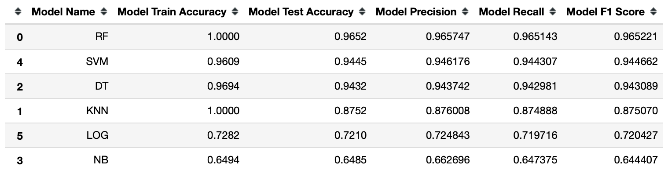
Model evaluations hold-out validation
Hold out validation result is not conclusive as the train data set may be biased even though it is randomized.
Use 80/20 Train/Test sets (Total 20000 observations)
RandomForest seems a potential candidate with highest model accuracy, precision and recall

Slide 8
Model evaluations k-fold cross validation

Slide 9
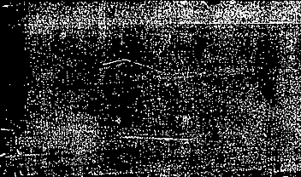

Model evaluations ROC/AUC validation
Model | Roc_auc_score
RF | 0.9992
SVM | 0.9967
KNN | 0.9958
Log | 0.9448
NB | 0.9382
DT | 0.9364

Slide 10

Confusion matrix Random Forest
Accuracy: 0.9652
Precision: 0.9657
Recall: 0.9651
F1 Score: 0.9652

Slide 11
Feature importance
For letter recognition, instead of width and height of the letter, both x_edge and y_edge are the important features. In fact, the measurements of the letter edges (from left to right, top to bottom) provide the distinct characteristics of a letter.

Slide 12
Principle component analysis (PCA)
Use RF model with PCA , it seems 12 components are able to cover 98%+ variance
Num of components | Accuracy | F1 Score
16 | 0.965 | 0.9652
12 | 0.934 | 0.9339
[0.26831082, 0.16400501, 0.10823812, 0.08548123, 0.06556958, 0.06105878, 0.05587125, 0.03891206, 0.03711862, 0.03068354, 0.02678855, 0.01657113, 0.01587067, 0.0134592 , 0.00742398, 0.00463745]

Slide 13
Conclusion
Using classification model is one of the methods to perform letter recognitions. More sophisticated deep learning methods like TensorFlow or neural networks can be used to classify complex objects. For example, picture recognition, audio real time noise suppression etc.

